Slide 1
The next live presentation will begin
at 5:00 pm

Slide 2
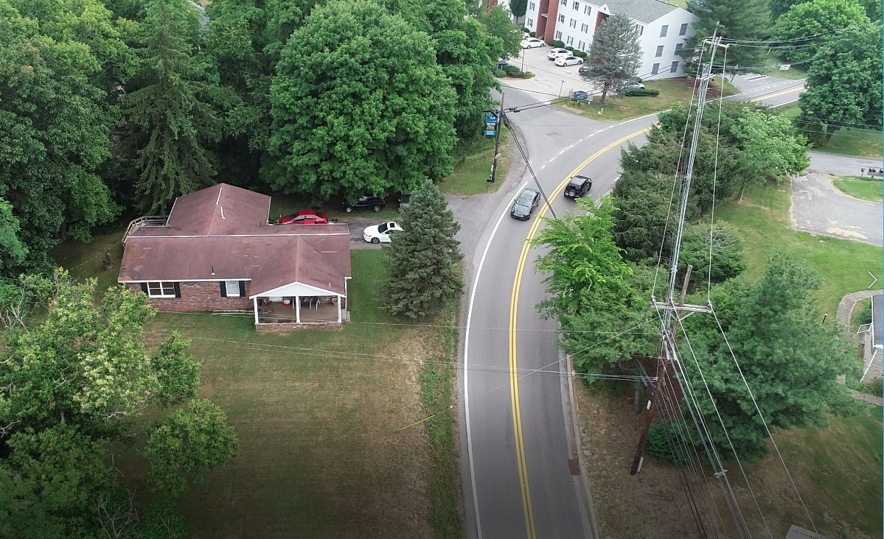
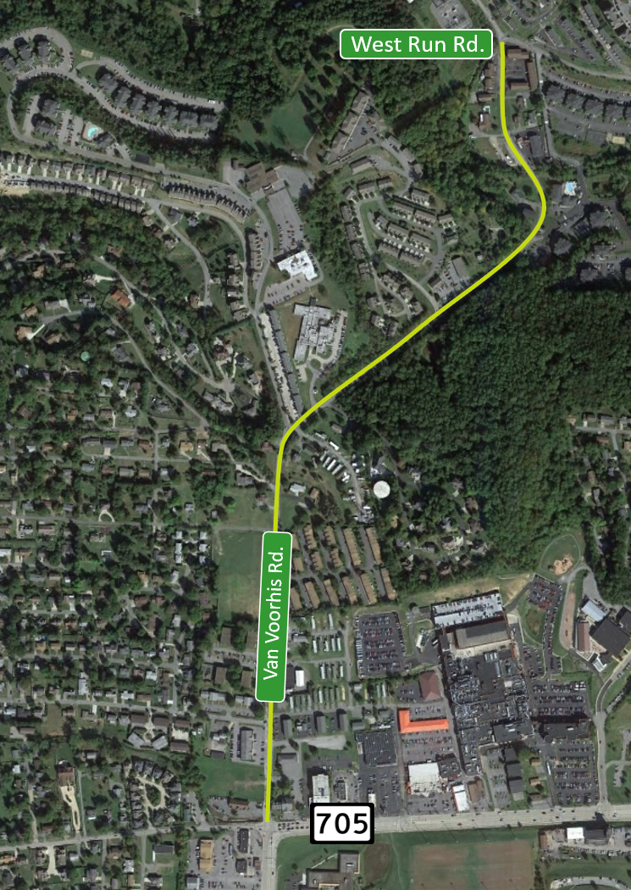
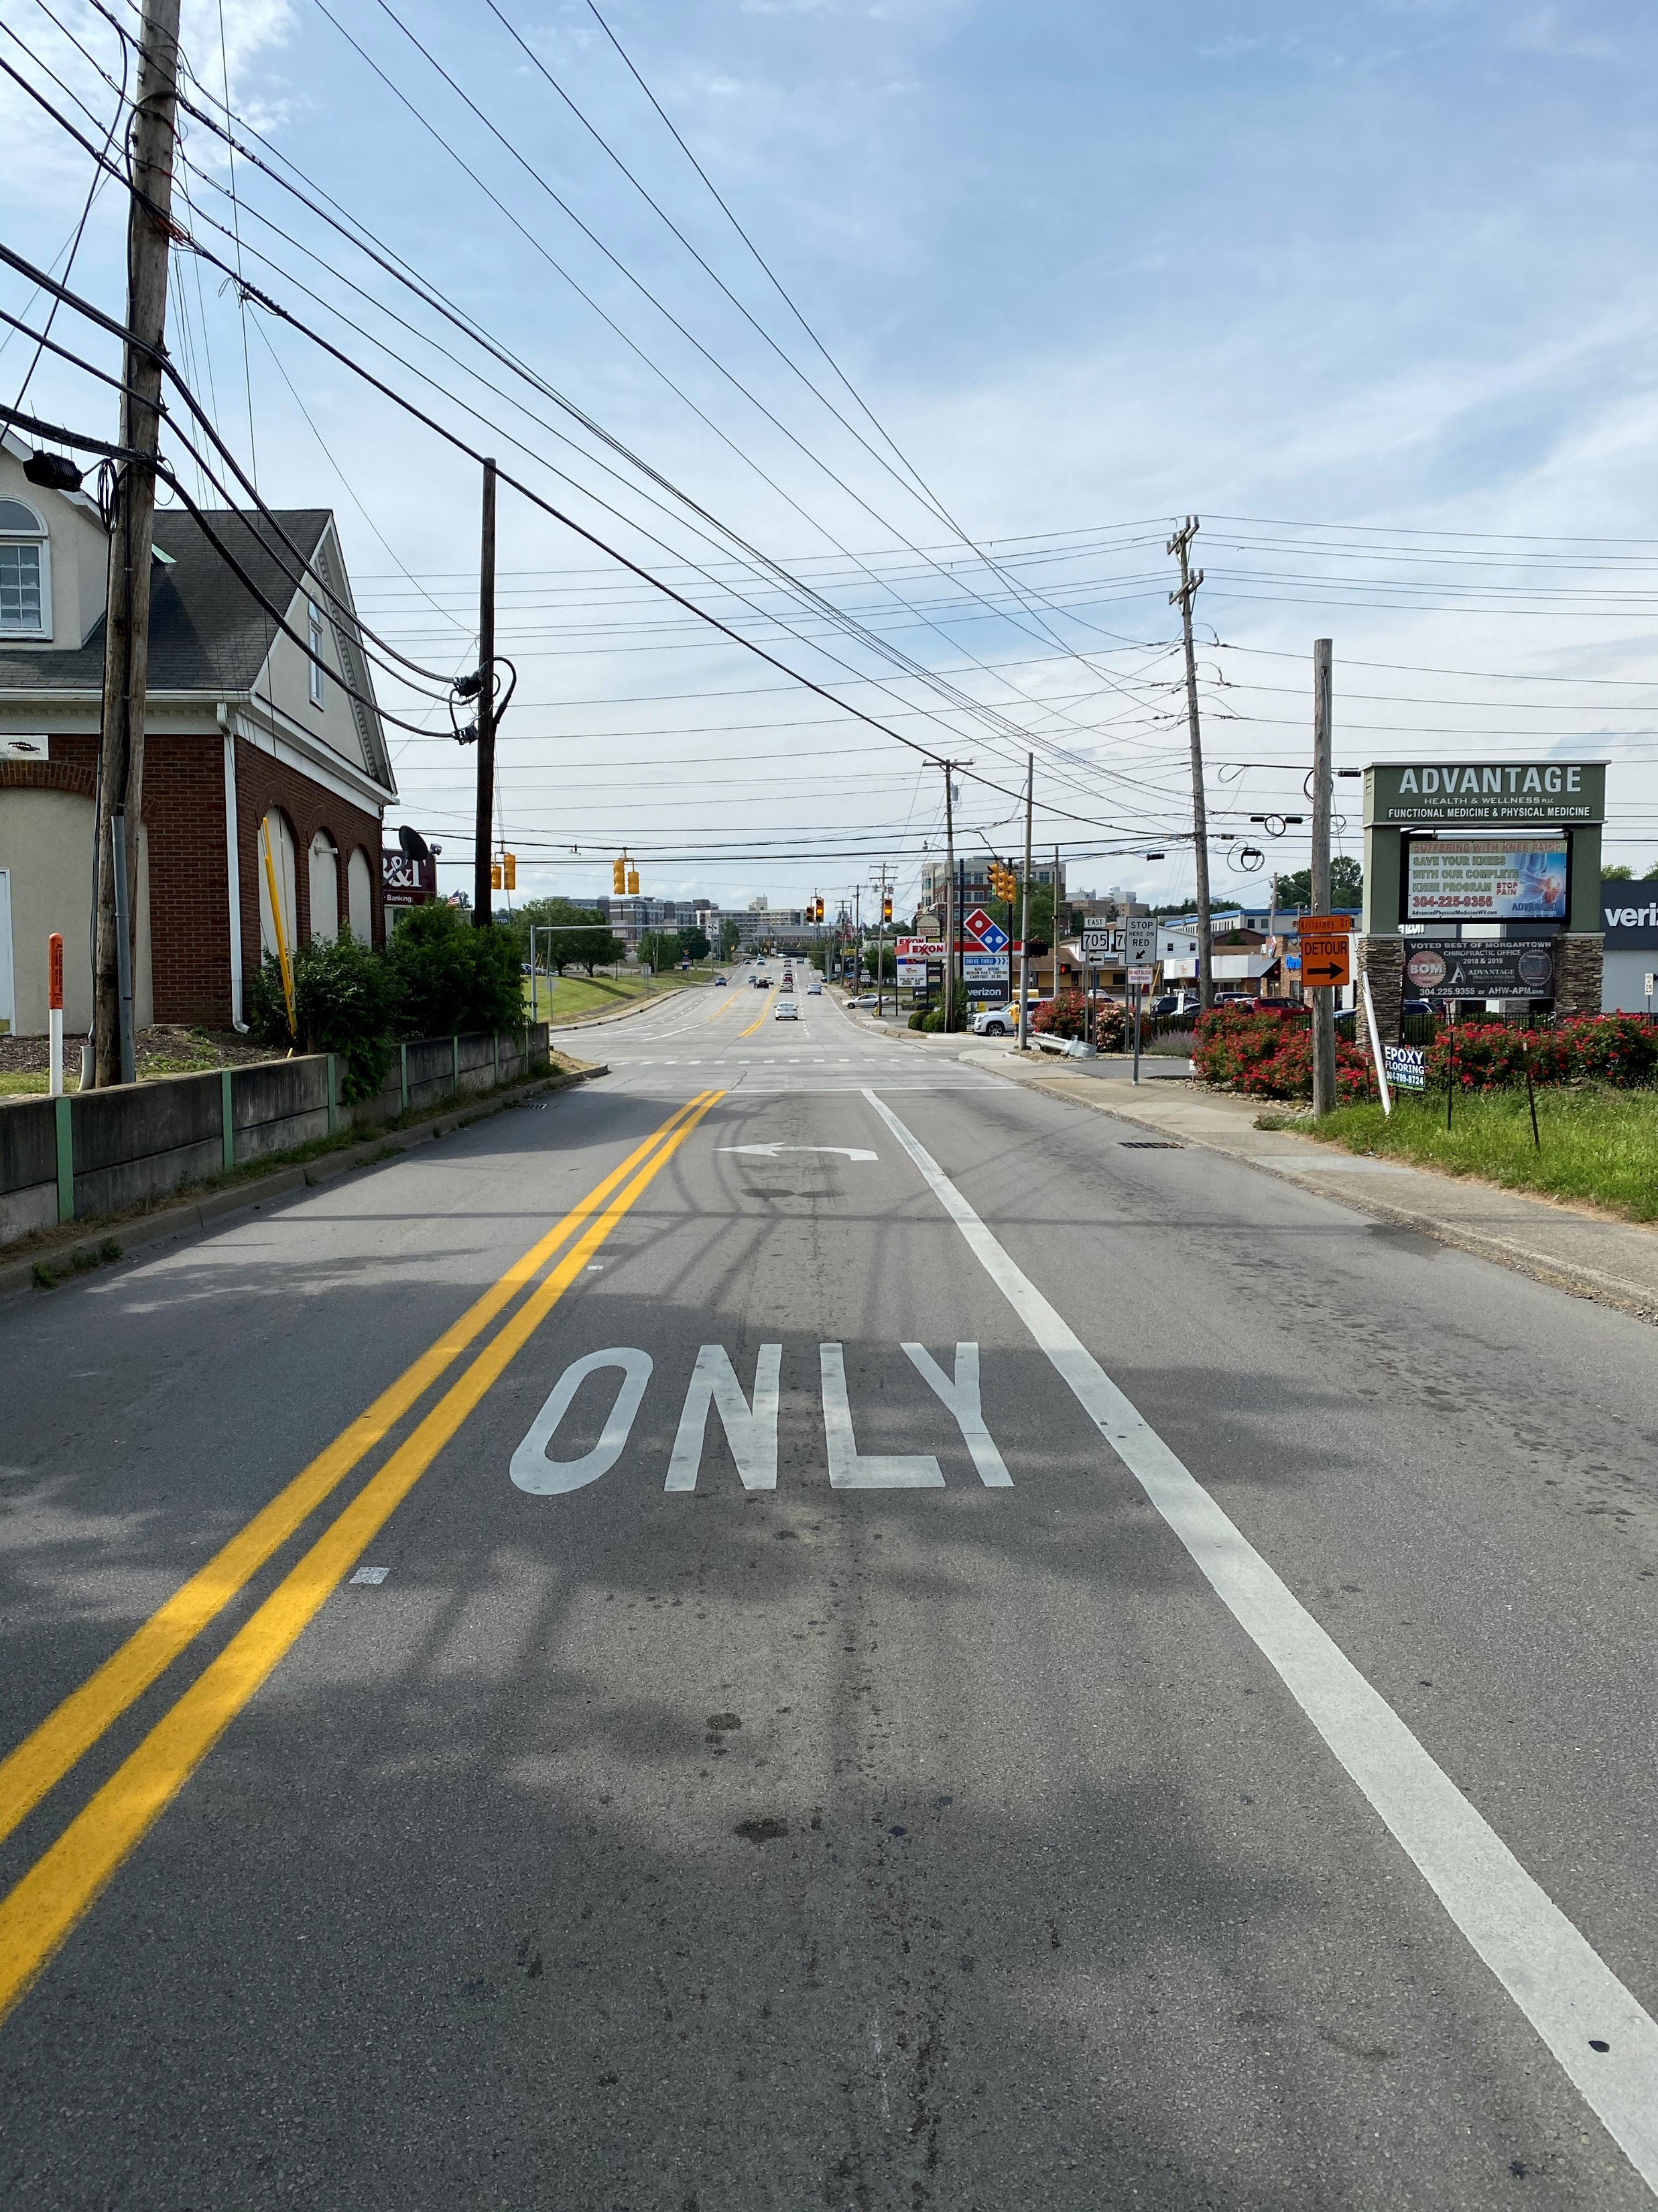
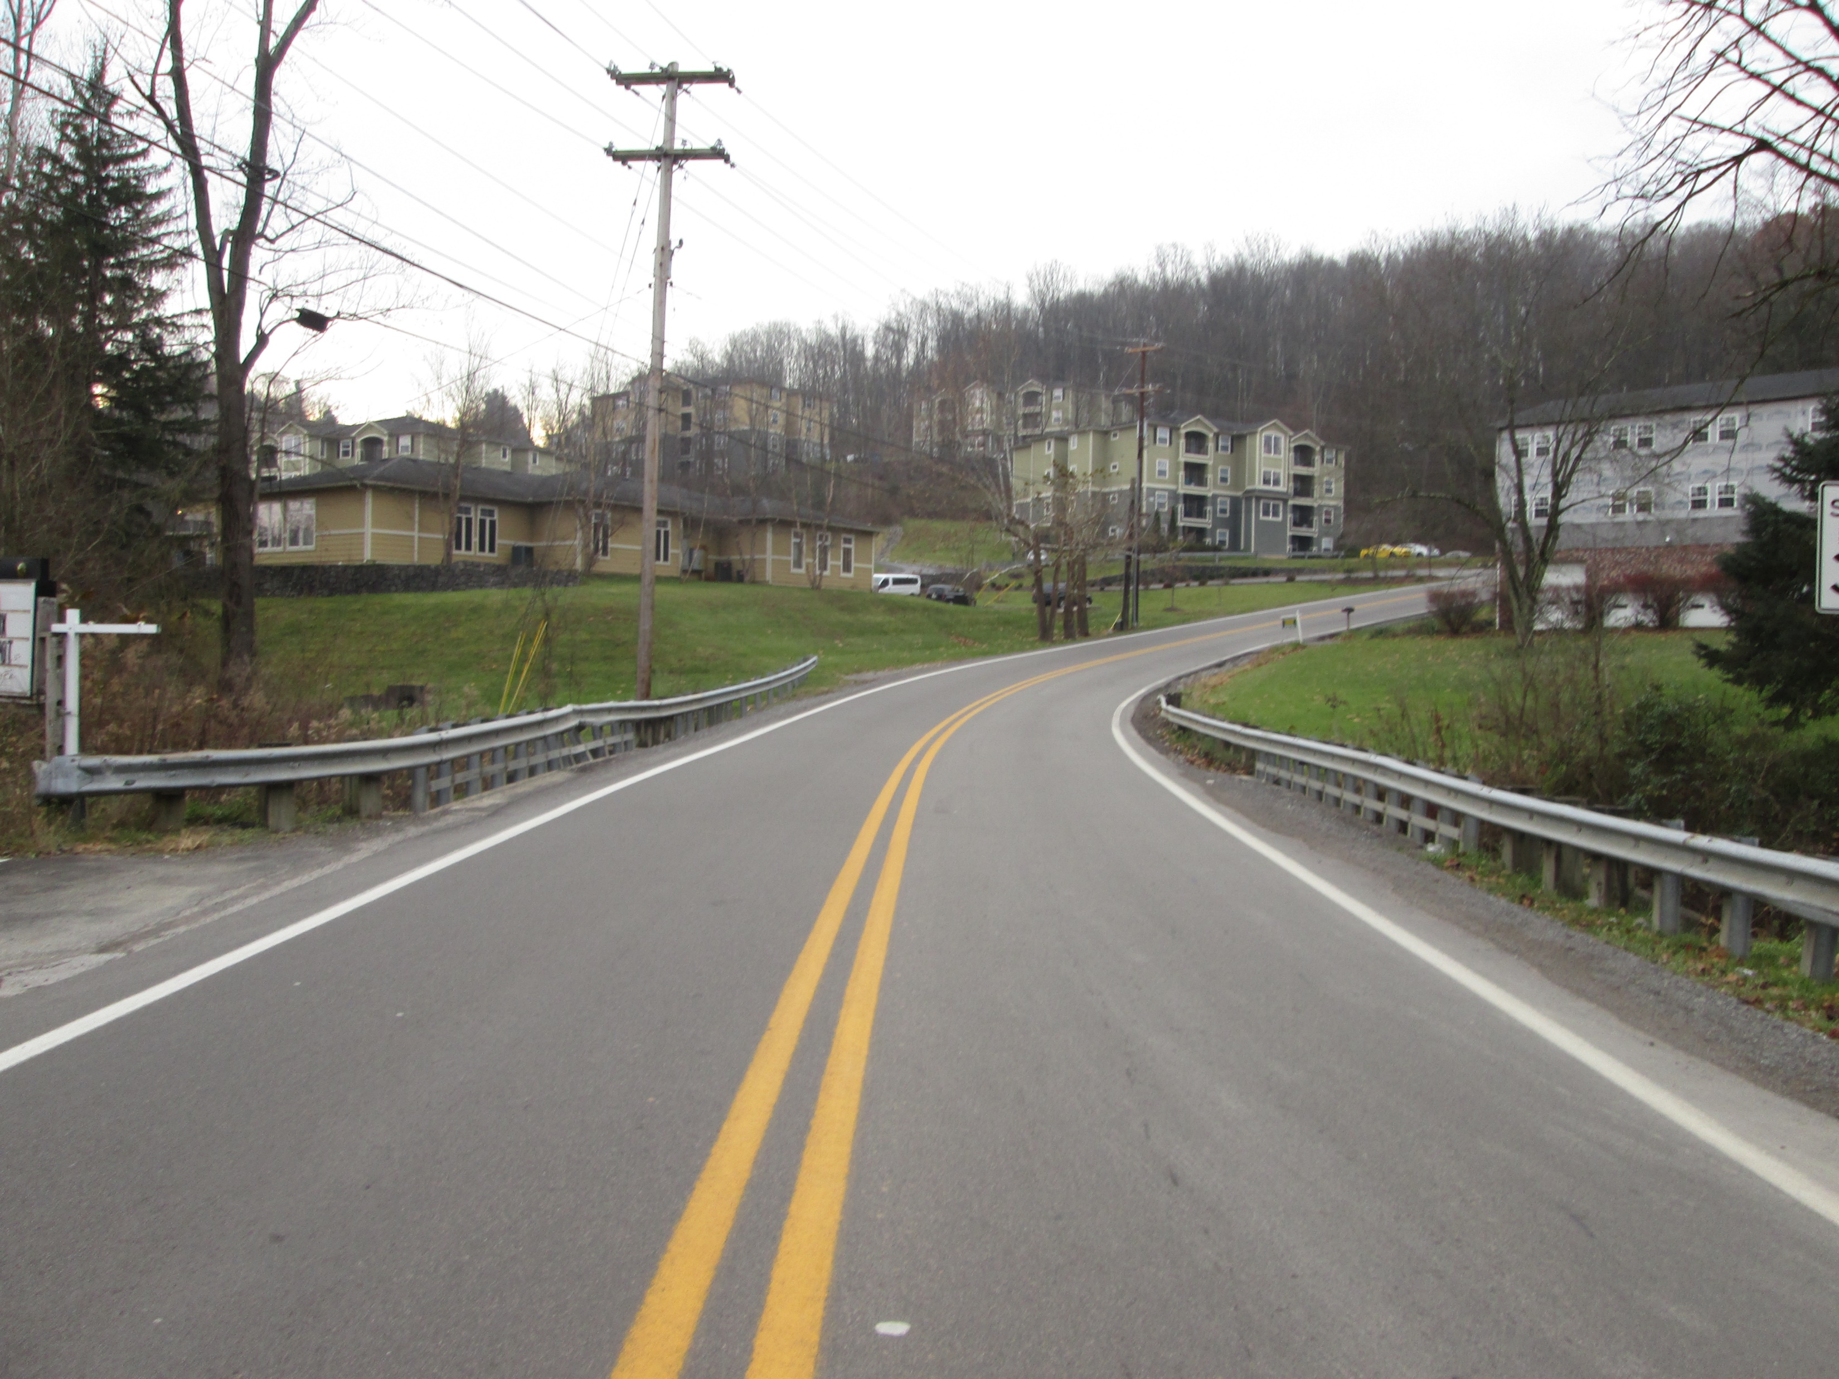
Van Voorhis Road Public Meeting U331-59-0.00 00
Public Meeting
August 10, 2020

Slide 3
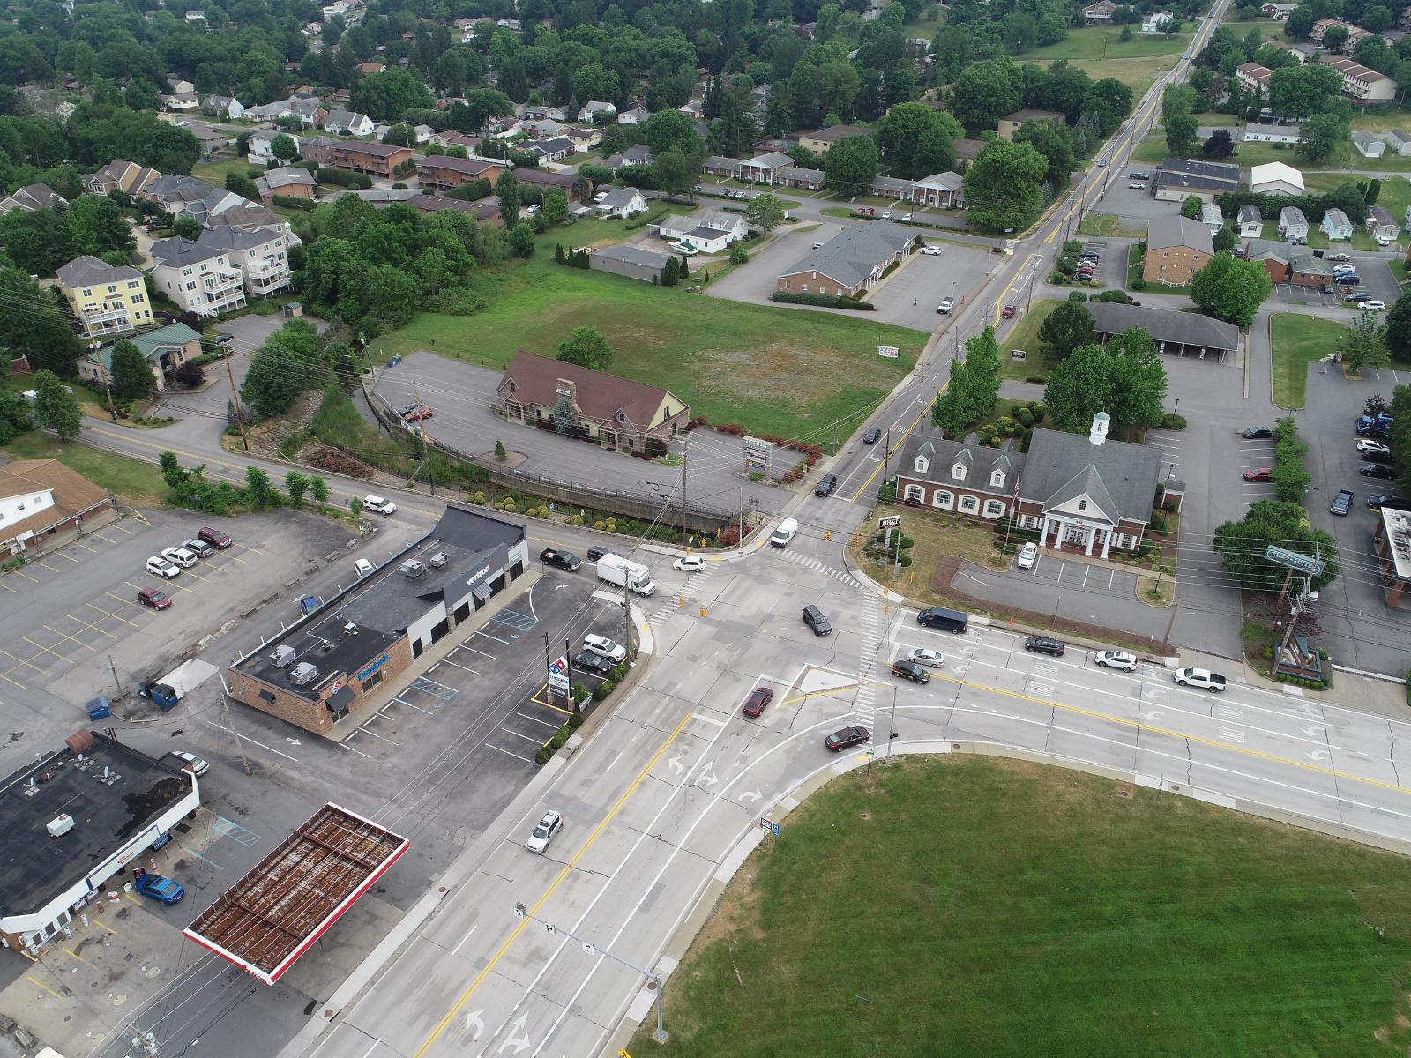
PURPOSE & NEED
The Purpose and Need for the project is to improve the infrastructure on Van Voorhis Road from WV 705 to south of West Run Road
Recurring Traffic Congestion
Narrow Lanes
Deficient Roadway Geometry
Limited Pedestrian Infrastructure
Limited Drainage
WV 705 with Van Voorhis Rd (CR 59)

Slide 4
PROJECT DESCRIPTION
Project Limits From WV 705 To South of West Run Rd
Design and Traffic Study Identified Improvements
Intersection and Geometric Infrastructure Improvement
Significant Challenges and Obstacles: Terrain, Existing Development, Utilities, Traffic Volume

Slide 5
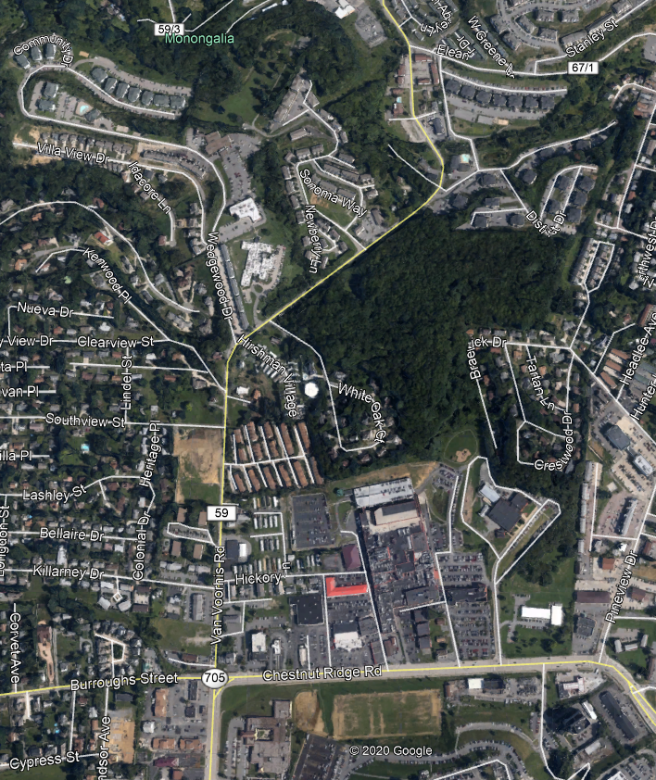
IMPROVEMENTS
WV 705 Intersection Improvement & Widening
Sidewalk Extension to Southview Street
Southview Drive & Clearview Ave Grade Improvement
Wedgewood/Hirshman Village Geometric Improvements
Retaining Walls Added To Reduce Impacts
Paved Shoulders
Bridge Replacement at West Run

Slide 6
Environmental impacts
This project will be processed as a National Environmental Policy Act (NEPA) Categorical Exclusion (CE) document. The process to develop a CE involves both conducting field reviews and coordinating closely with a variety of federal, state and local regulatory agencies to determine which natural, cultural, socioeconomic and other resources may be affected by the project.
Key resources include:
Wetlands
Rare, Threatened and Endangered Species
Wildlife
Communities
Property Effects
Historic Resources
Archeological Resources
Noise
Air Quality
Parks, Recreational Facilities
Hazardous Materials

Slide 7
Summary of
Environmental impacts
Chart is being updated for Estimates
Environmental Attributes | No-Build Alt. | Build Alt.
Residential/Commercial Displacements | None | Yes
Historic Resources | None | None
Archaeological Resources | None | None
Wetlands and Streams (Encroachment) | None | Minimal
Rare, Threatened and Endangered Species | None | None
Section 4(f) Impacts (parks, recreation and refuge lands and historic properties) | None | None
Noise | None | None
Air Quality | None | None
Hazardous Waste/Underground Storage Tanks | None | None
Engineering
Roadway (Length of Improvements) | None | 0.95-mile
Bridge(s) | None | 1
Maintenance of Traffic (MOT) | None | Temporary single lane closures
Project Costs
Construction | N/A | $11M
Utilities and Right of Way | N/A | $5M
Total | N/A | $16M
WV 2 Northbound STA 80+00

Slide 8
WV 705 Intersection
Add Through Lane to Improve Capacity of Intersection and Reduce Delay
Modify Island on WV 705 To Improve capacity and Pedestrian Safety
Modify Traffic Signal Based on New Lane Configuration
Install New Sidewalk Ramps
Existing CR 59 Southbound
Proposed CR 59 Southbound

Slide 9
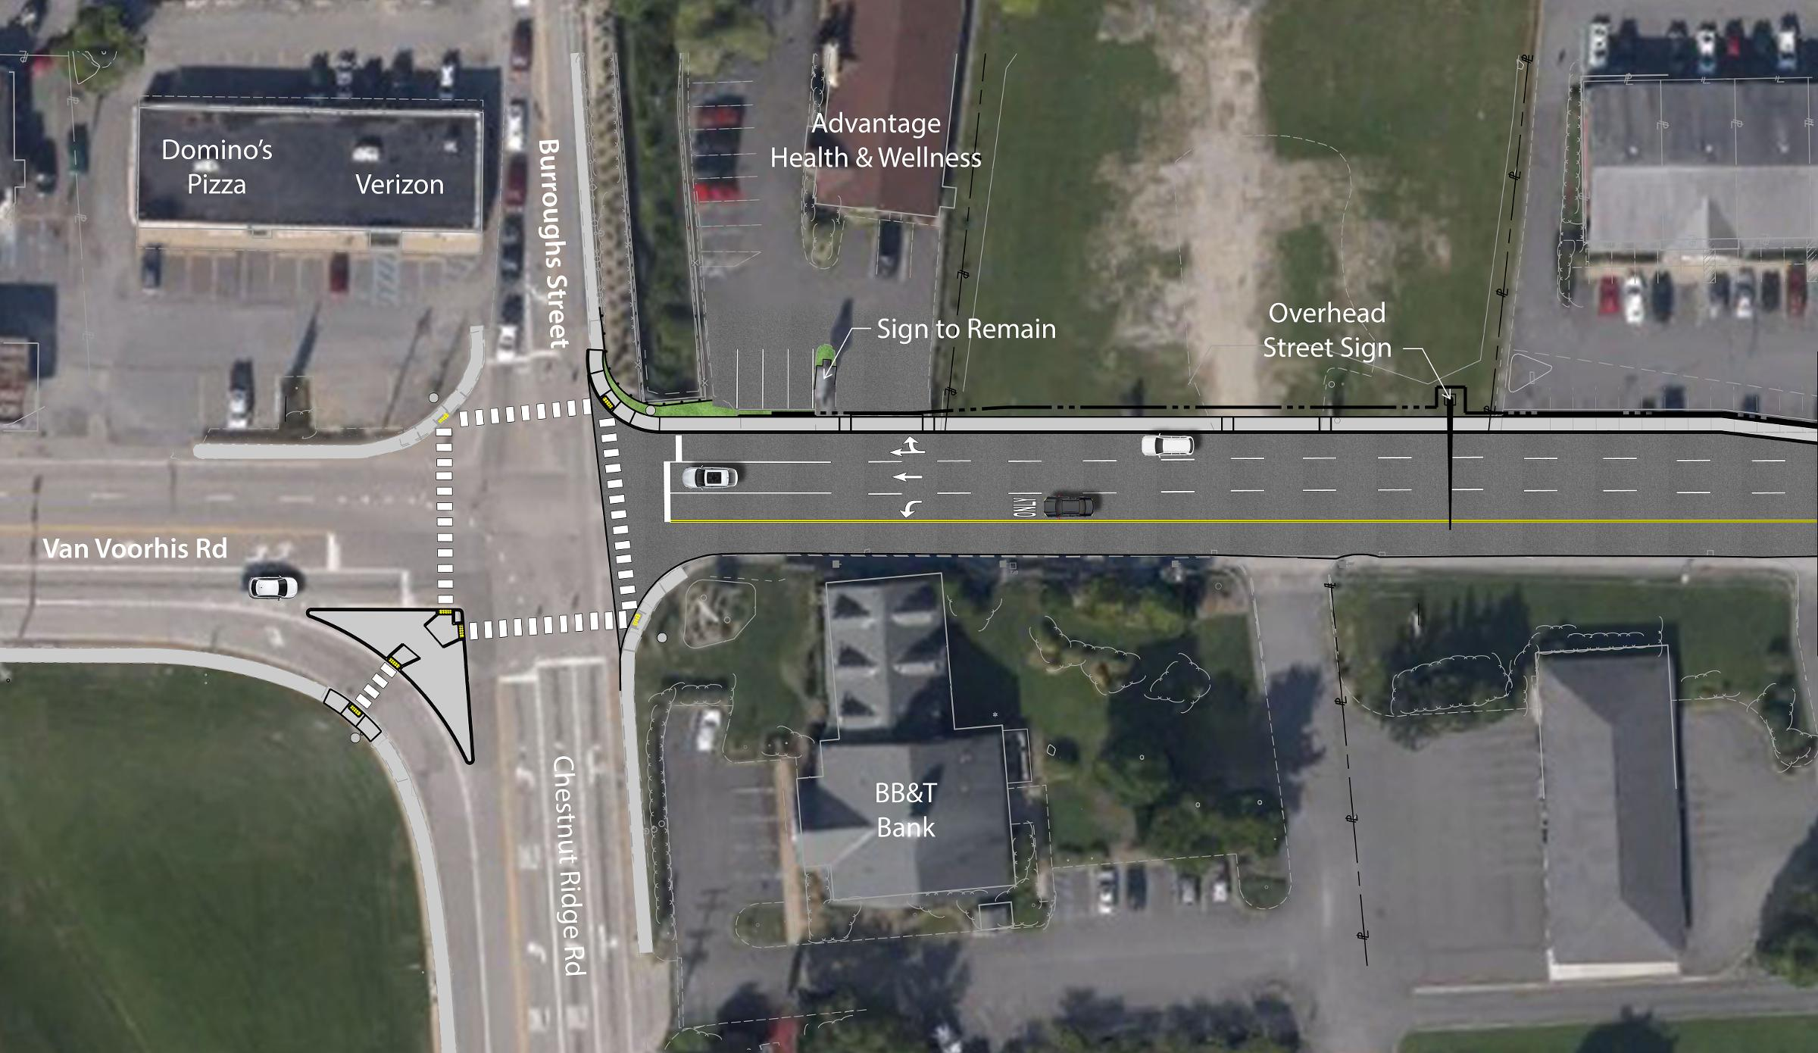
WV 705 Intersection
Proposed WV 705 Intersection

Slide 10
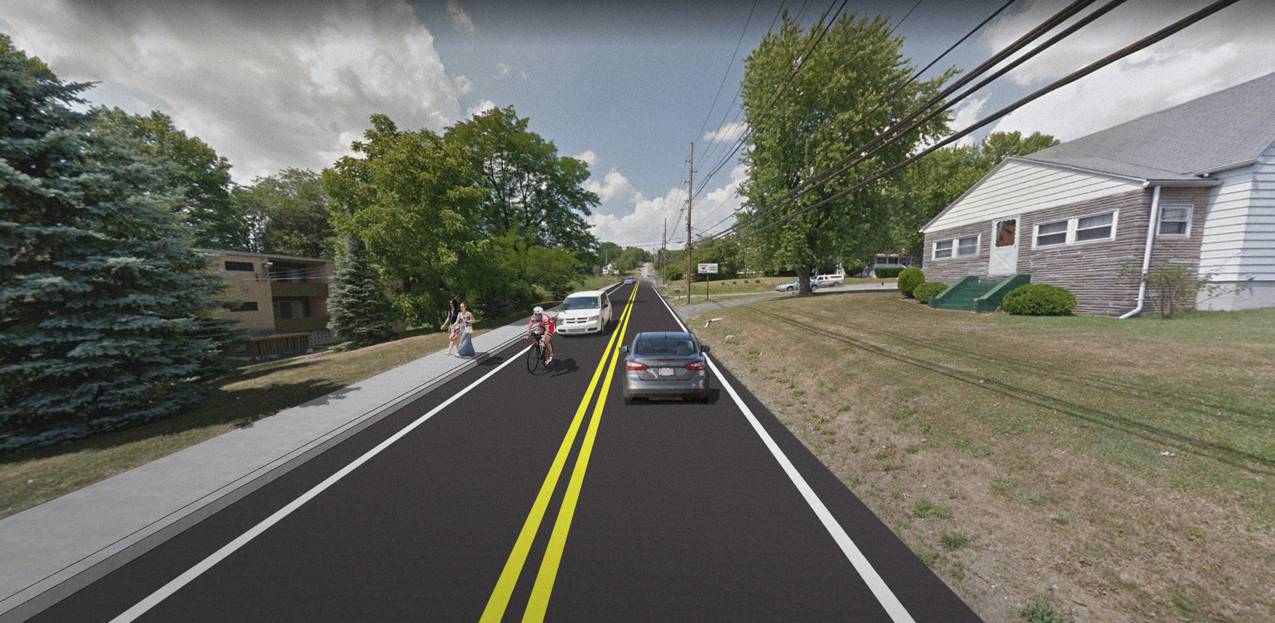
PEDESTRIAN IMPROVEMENTS
Sidewalk Renovated and Extended from WV 705 to Southview Drive
Enhanced Pedestrian Accommodation at WV 705
Paved Shoulders provided from Southview Street to south of West Run Road
Proposed Sidewalk Extension

Slide 11
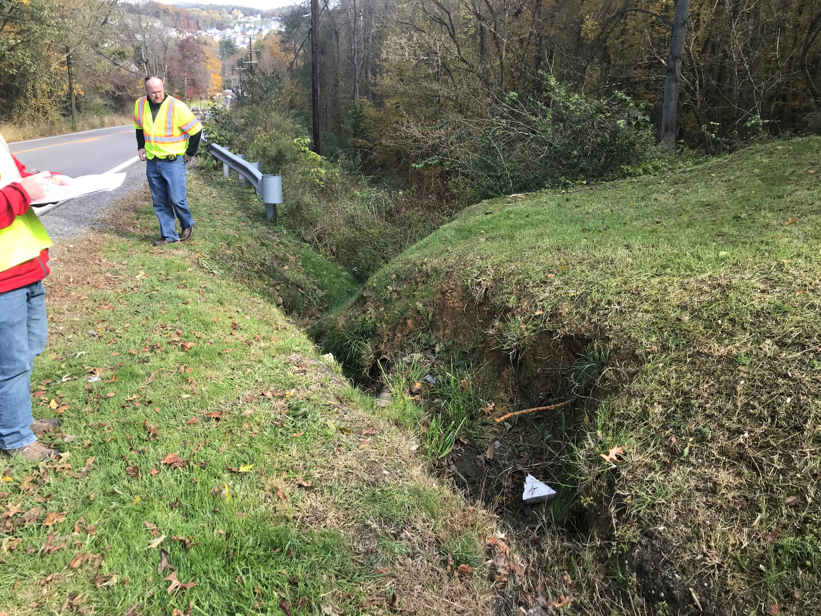
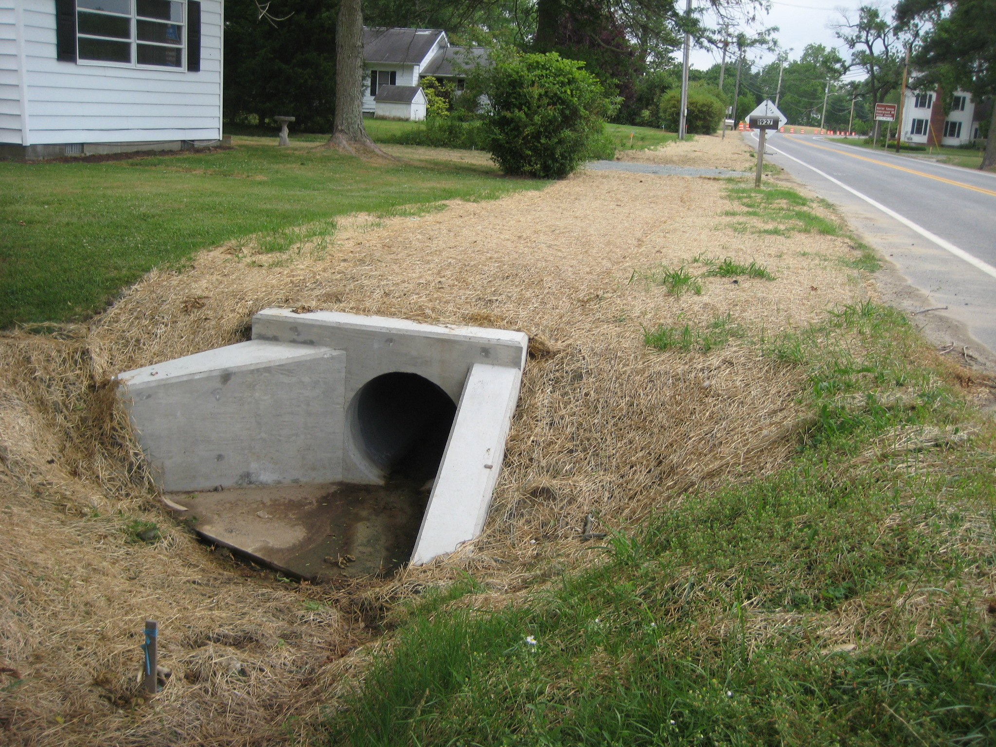
DRAINAGE IMPROVEMENTS
Drainage Improvements throughout project
Additional inlets to collect more runoff from travel lanes
Closing and piping eroding ditches
Armoring ditches to prevent erosion
Existing Van Voorhis Ditch
Example Enclosed Drainage

Slide 12
Intersection Southview DRIVE
Raise Grade to improve entering Van Voorhis Road
Flatten Grade at Intersection of Van Voorhis to Improve Walkable Path
Existing Southview Drive
Existing Southview Drive

Slide 13
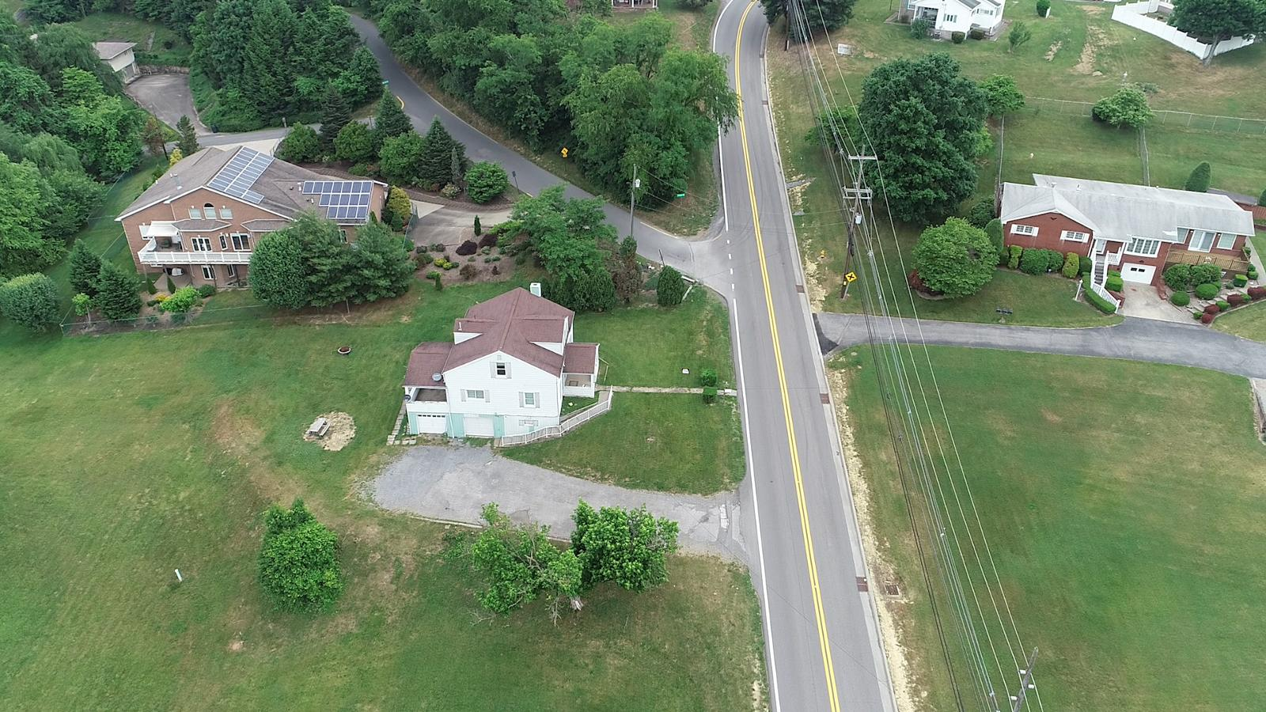
Intersection CLEARVIEW street
Raise Grade to improve entering Van Voorhis Road
Flatten Grade at Intersection of Van Voorhis to Improve Walkable Path
Existing Clearview Ave

Slide 14
Wedgewood Curve improvement
Sharp Horizontal Curve
Steep Vertical Grades
Limited Sight Distance
Rear End Crashes Northbound
Narrow Roadway
WV 2 Northbound STA 80+00
Existing Condition – Van Voorhis at Wedgewood Drive

Slide 15
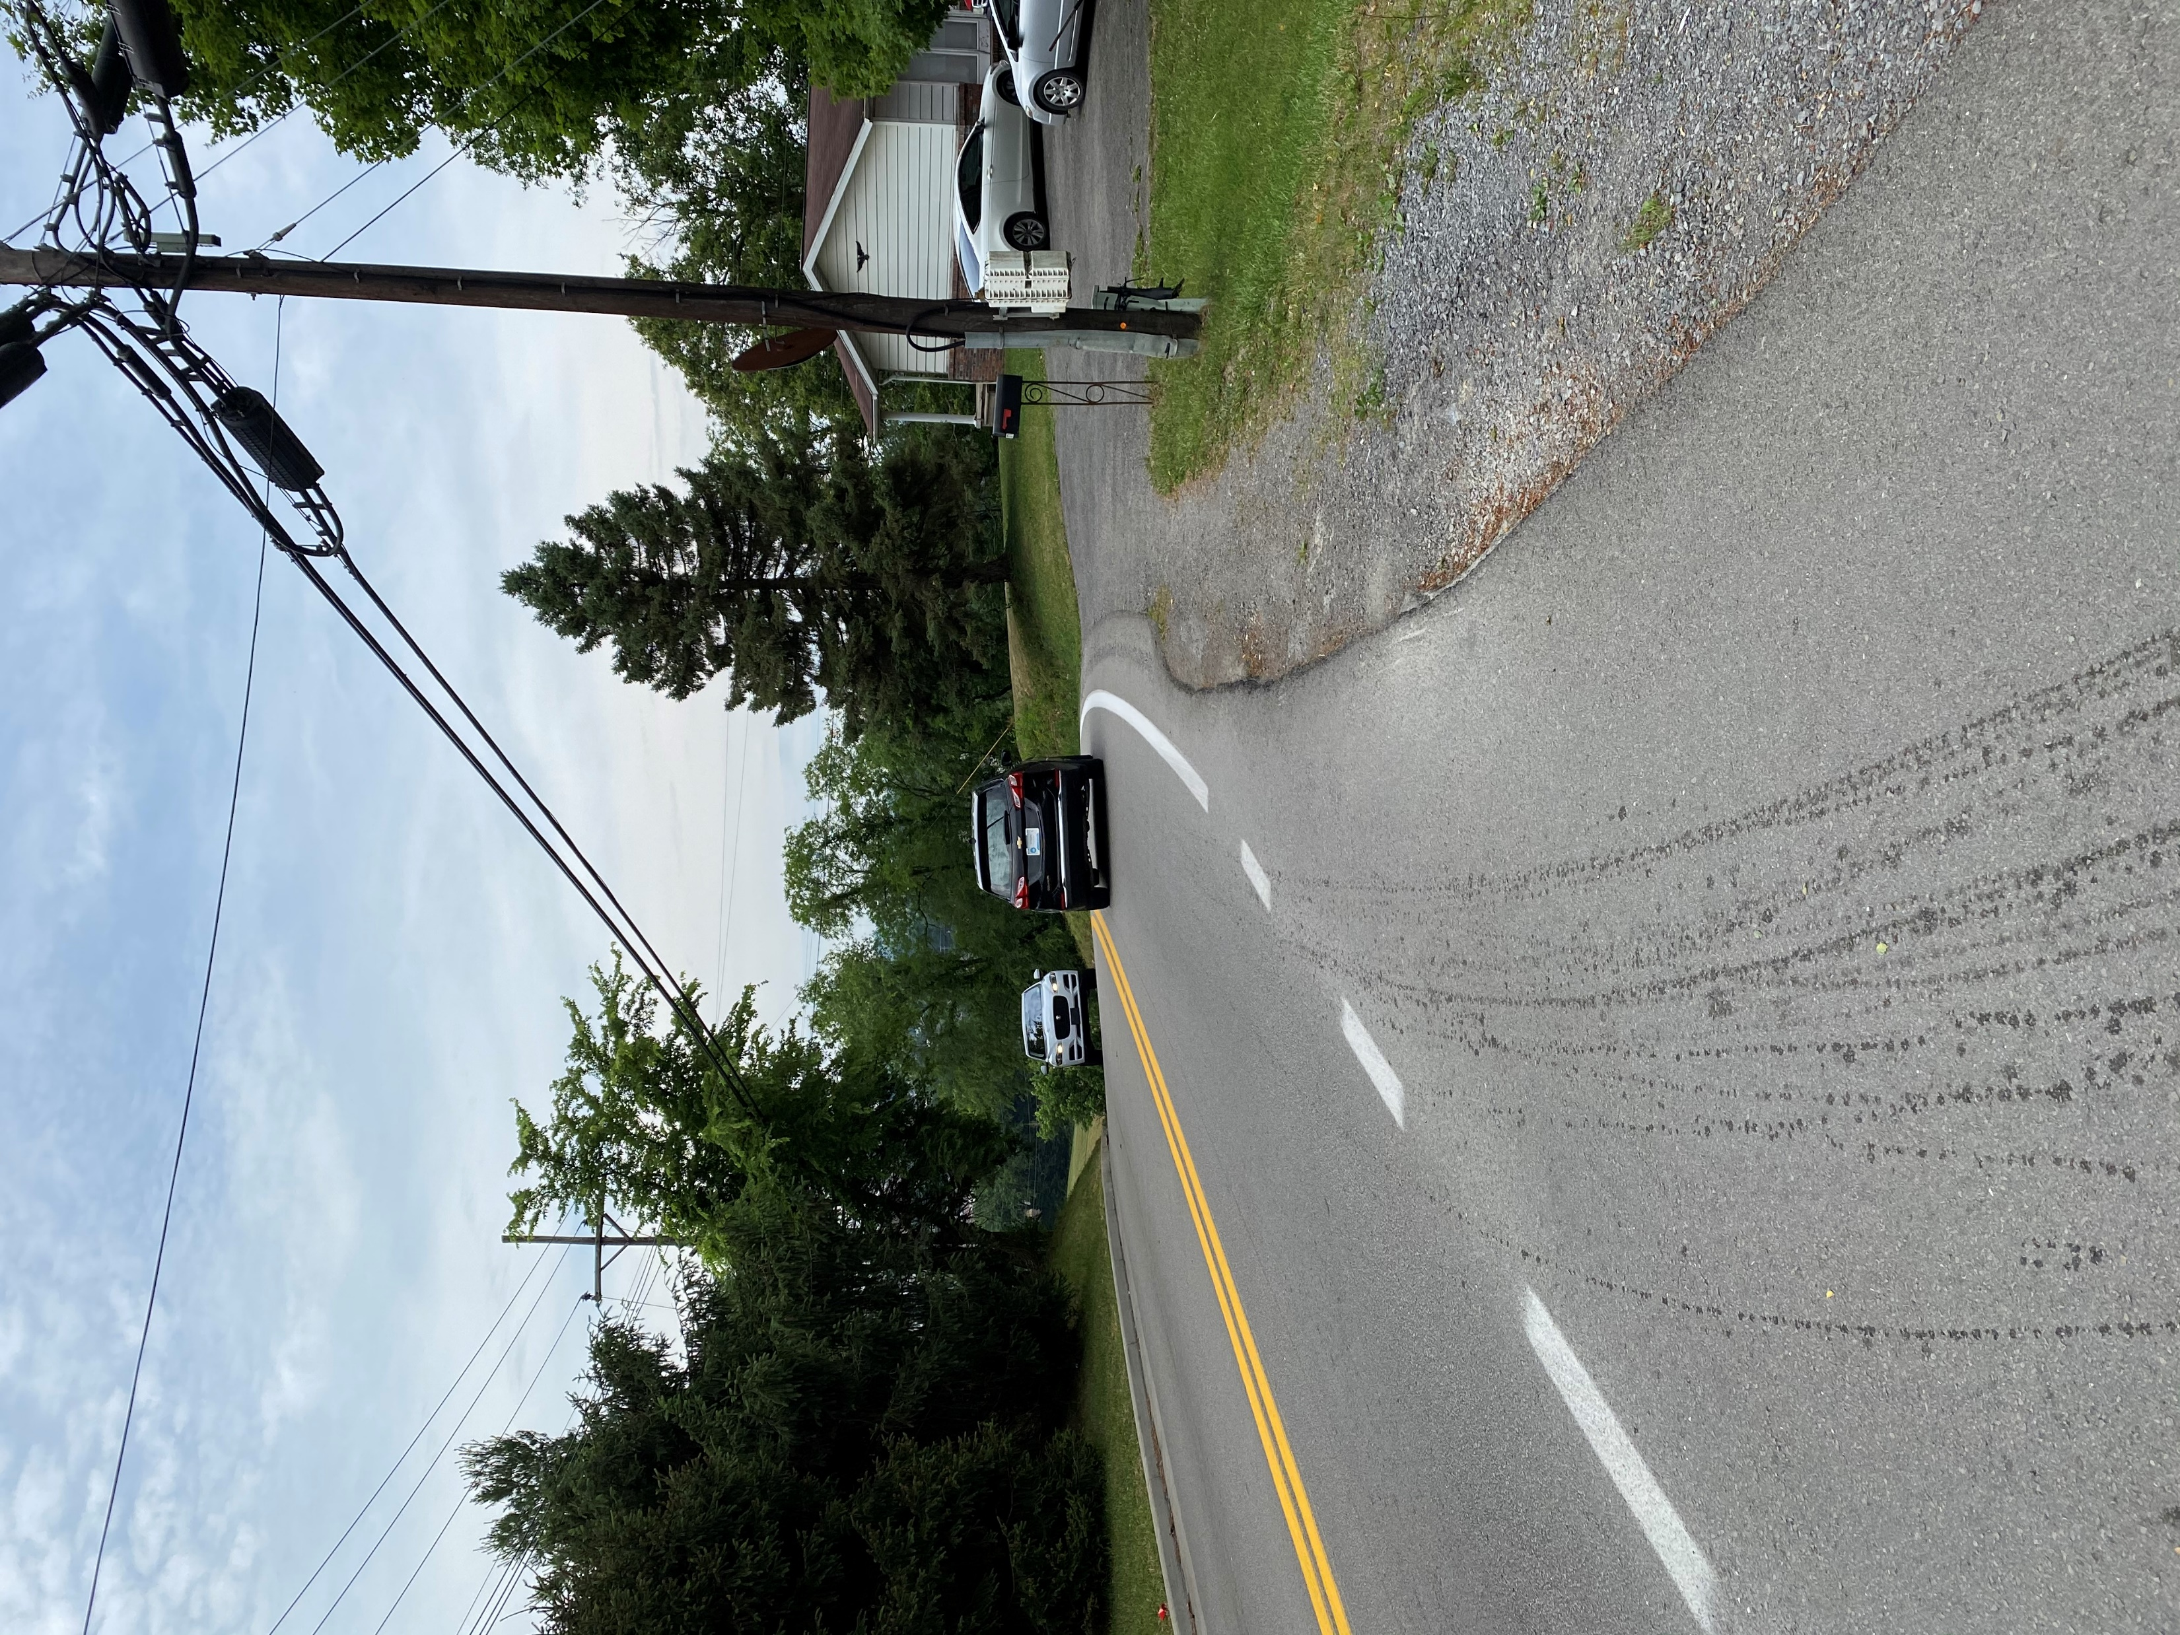
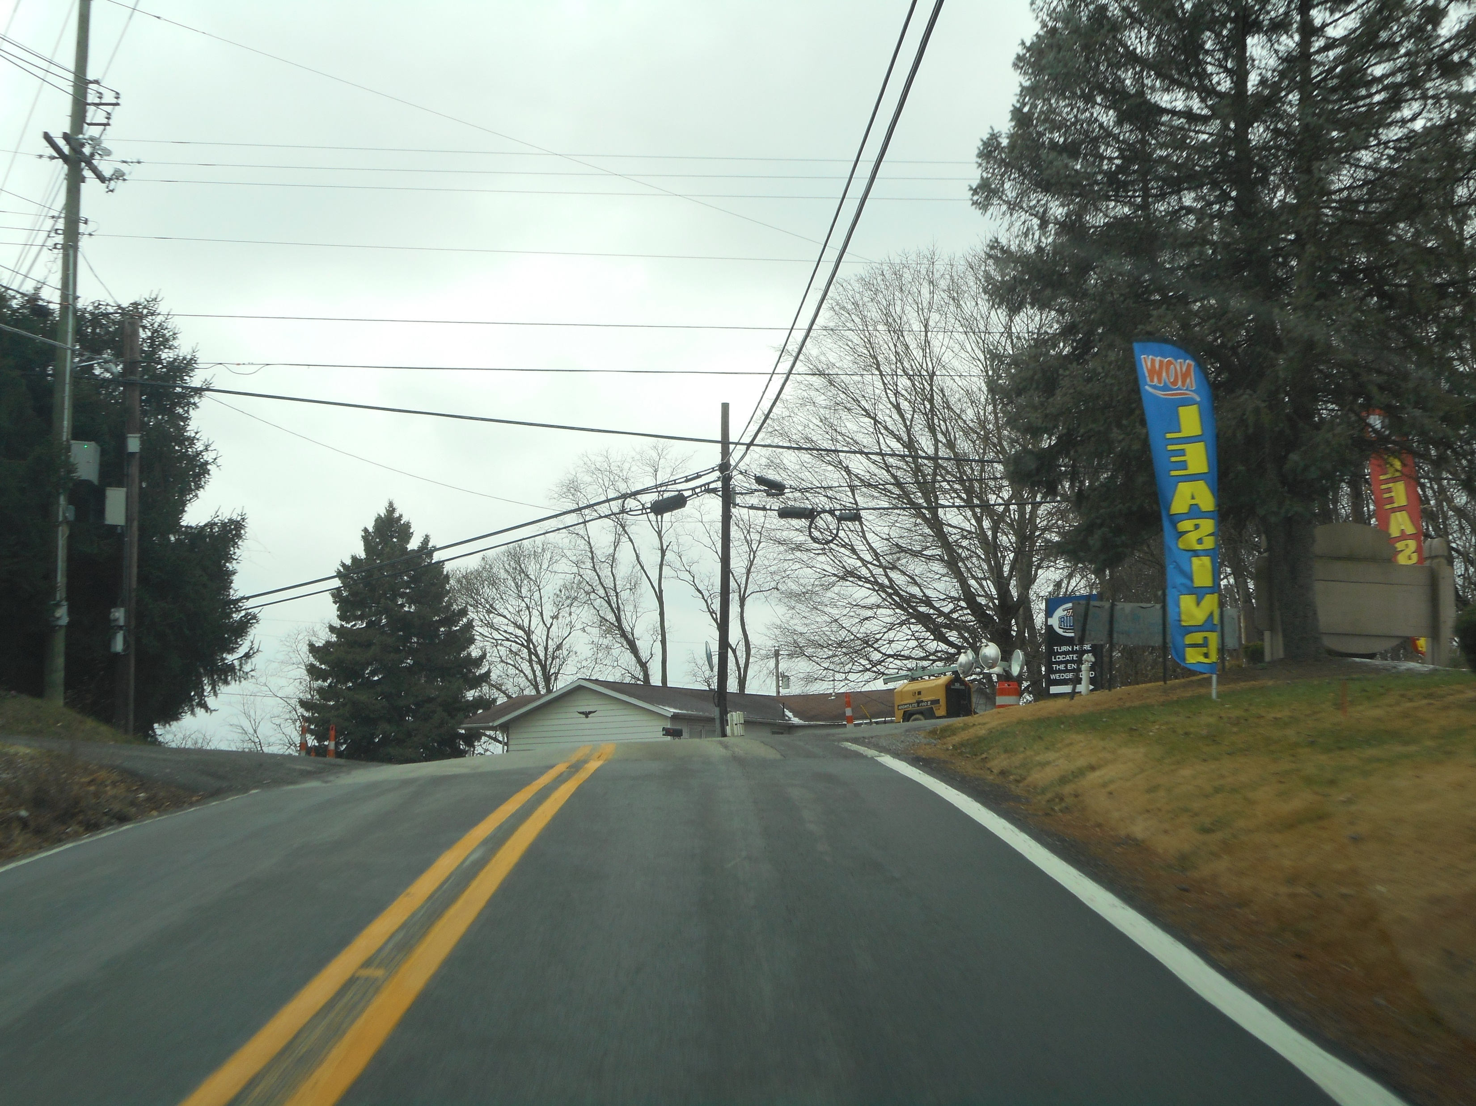
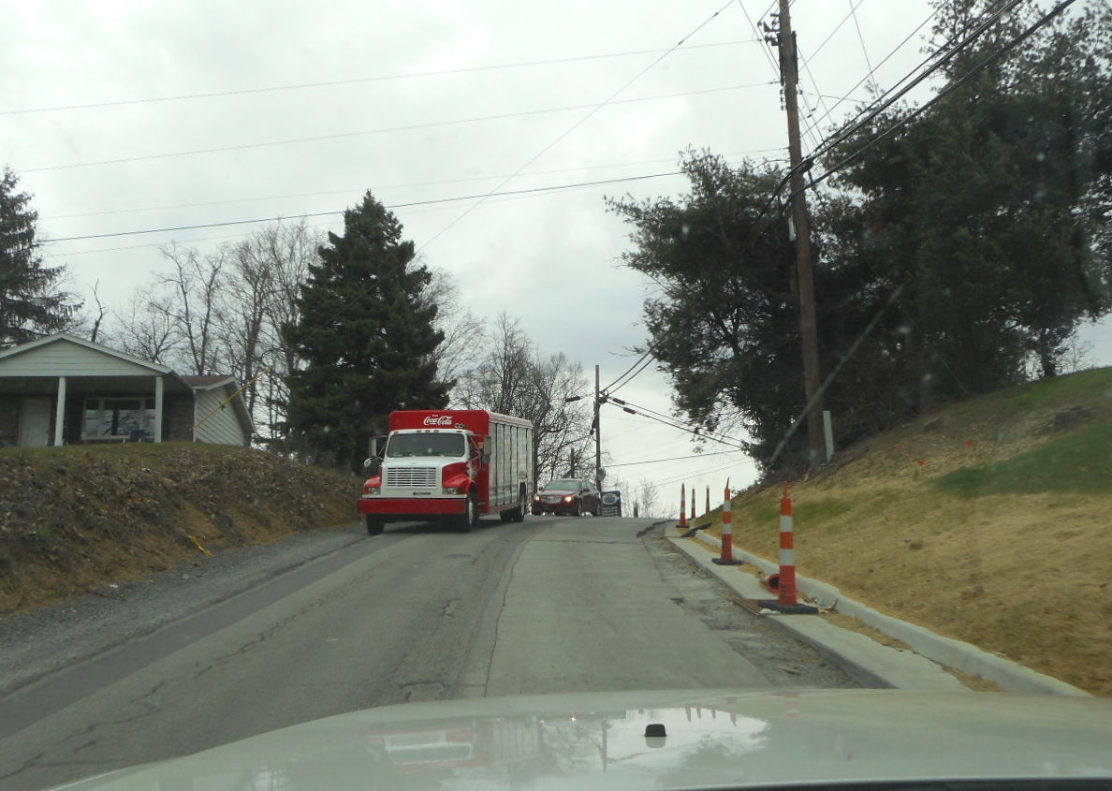
Wedgewood Curve improvement
Restricted Sight Distance
Realign Hirshman Village Closer To Top of Grade
Excavate Hillside To Improve Sight Distance
Horizontal Curve Improvement
Vertical Curve Improvement
Wedgewood Looking South
Hirshman Village Looking South
Southbound on Van Voorhis Road
Northbound on Van Voorhis

Slide 16
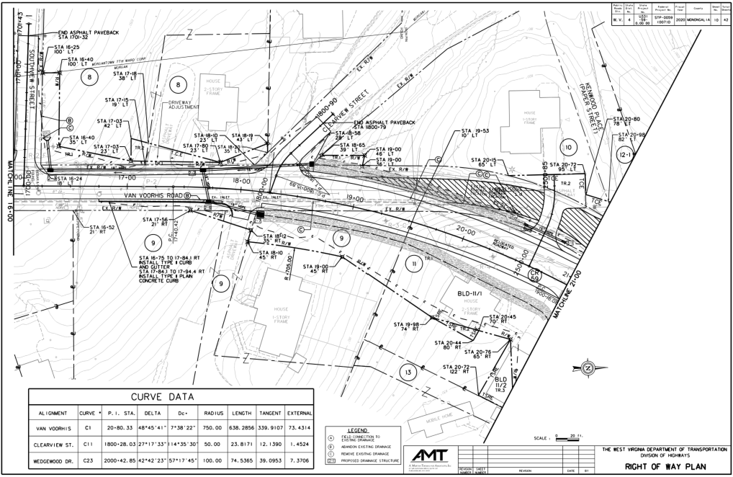
Wedgewood Curve improvement
Existing Condition – Van Voorhis at Wedgewood Drive
WV 2 Northbound STA 80+00
Post Construction – Van Voorhis at Westwood Drive

Slide 17
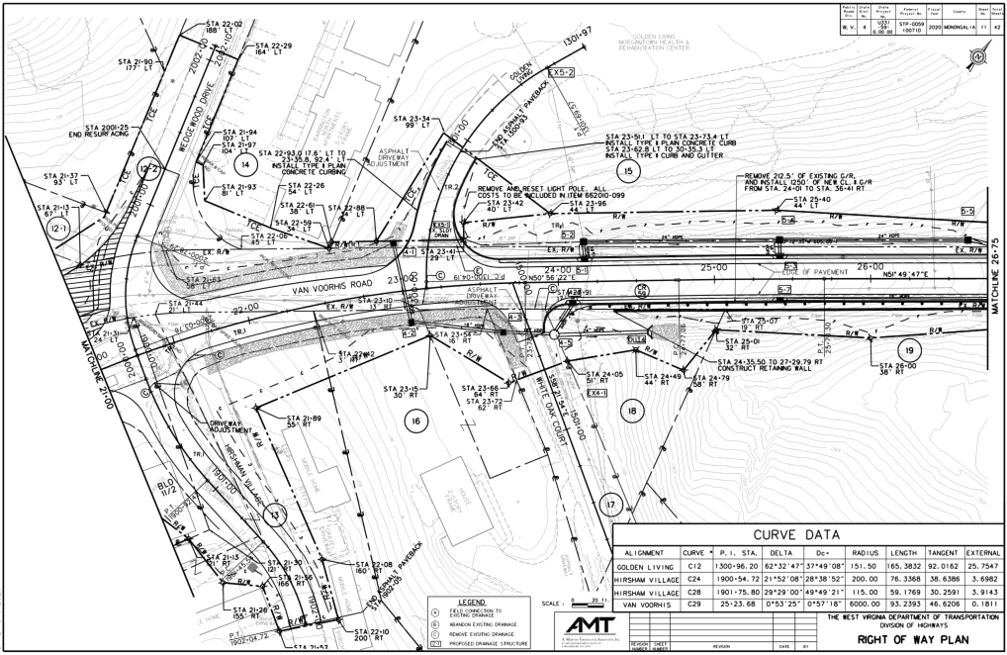
Wedgewood Curve improvement
Existing Condition – Van Voorhis at Wedgewood Drive
WV 2 Northbound STA 80+00
Post Construction – Van Voorhis at Westwood Drive

Slide 18
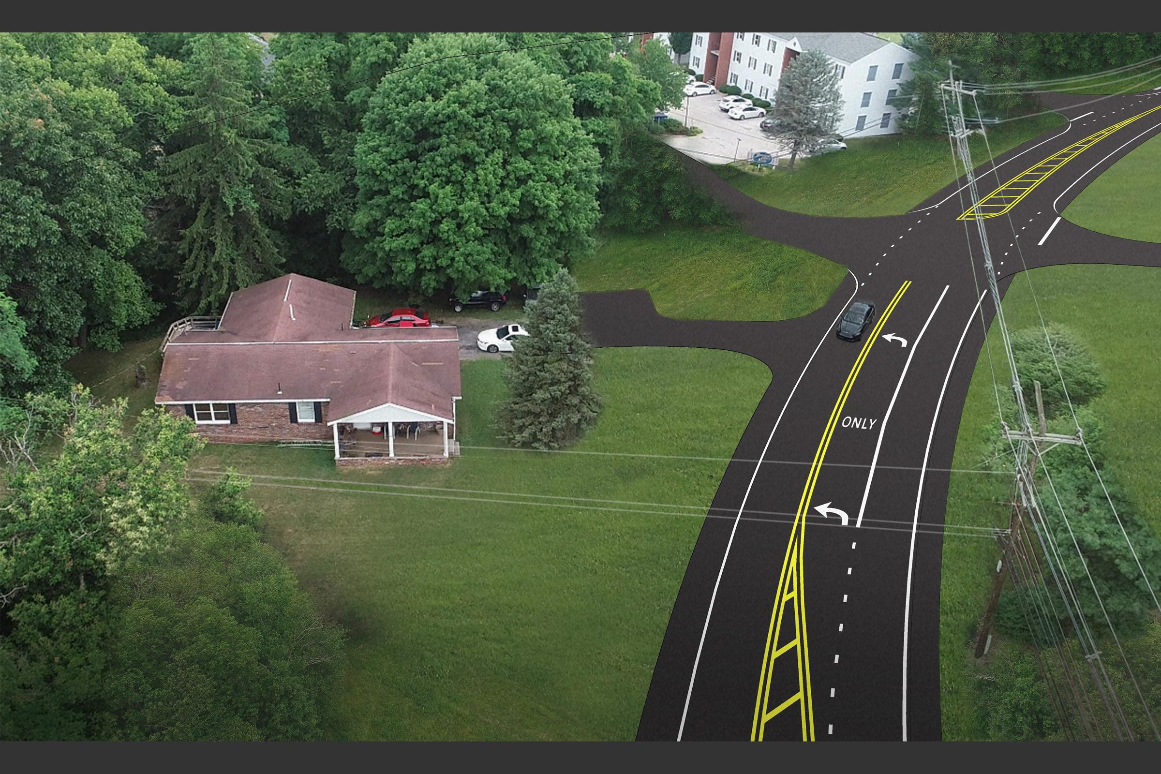
Wedgewood Curve improvement
Improved Horizontal Radius
Vertical Grade Reduction
Sight Distance Improved
Left Turn Lane to Wedgewood
Paved Shoulders
Existing Condition – Van Voorhis at Wedgewood Drive
WV 2 Northbound STA 80+00
Proposed Wedgewood Curve
Post Construction – Van Voorhis at Westwood Drive

Slide 19
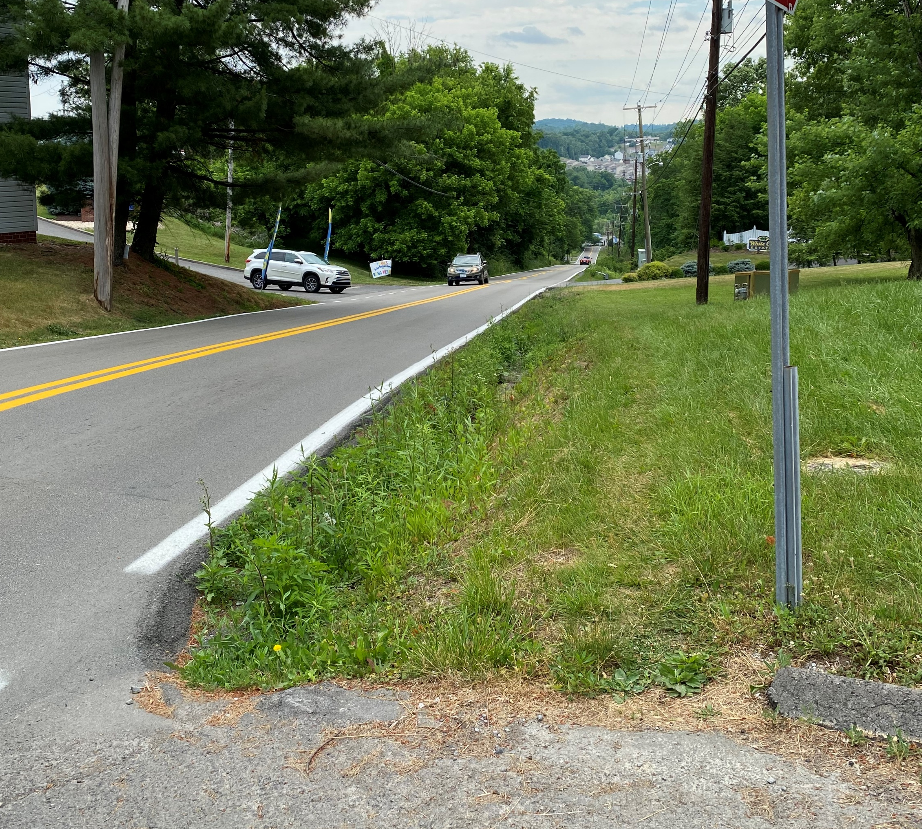
Paved shoulders
Reduce Run Off The Road Accidents and Bike and Ped Accommodation
WV 2 Northbound STA 80+00
Existing View North from Hirshman
Proposed View North from Hirshman

Slide 20
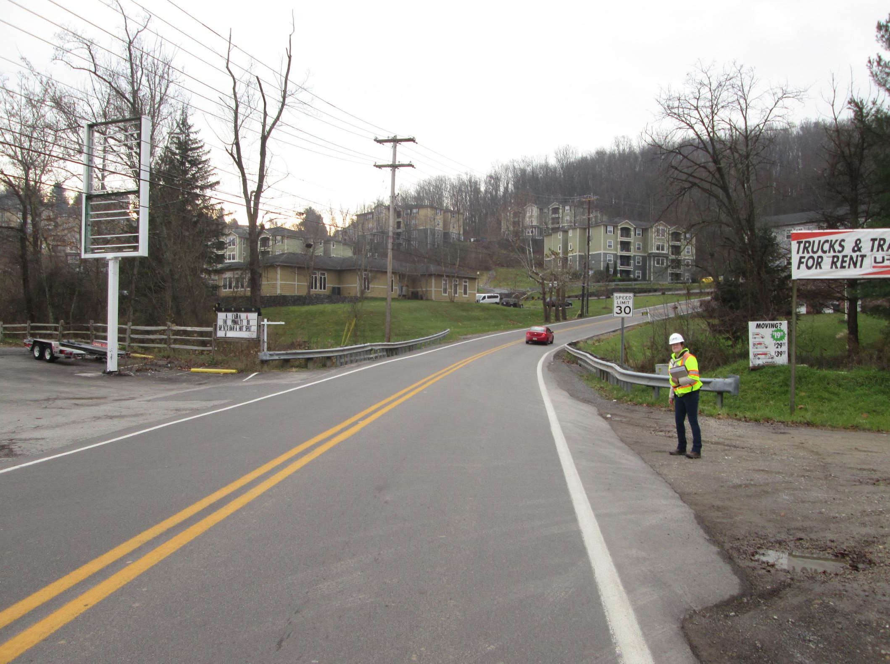
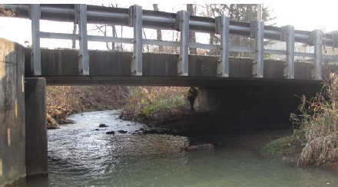
Bridge replacement
Existing Bridge
Flood Prone
Narrow Width
Adjacent Box Beam Design
No Parapets
Looking Upstream
WV 2 Northbound STA 80+00
Existing View South of West Run Bridge

Slide 21
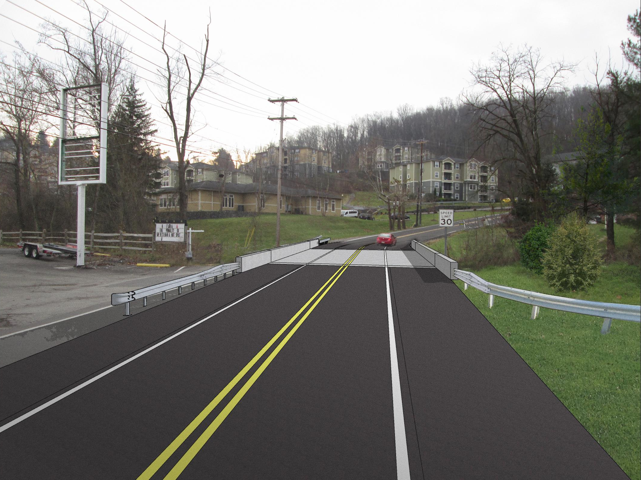
Bridge replacement
Proposed Bridge
Wider Bridge will allow for future potential Three-Lane configuration
Increased elevation reduces occurrence of overtopping
Long-term durable bridge replacement on high ADT roadway
Wider bridge improves future work zone traffic control
WV 2 Northbound STA 80+00
Proposed Bridge

Slide 22
RIGHT OF WAY IMPACTS
Project Requires right of way for Construction
22 Temporary Construction Easements (TCE) totaling 61,493 SF
29 Proposed Right of Acquisitions totaling 18,053
2 Structural Easement and Residential Relocation (TSRE)
Plans Available for Review
WV 2 Northbound STA 80+00

Slide 23
COMMENT PROCEDURES
Your Opportunity to Comment! Comment period open until September 10, 2020
There are a number of ways to provide your comments on the Van Voorhis project. These include:
Voicemail – to leave a message with your comments dial 855-925-2801, project code 9356.
Text - to text your comments dial 855-925-2801 (no code necessary to text).
Online – Visit the WVDOH Website at http://go.wv.gov/dotcomment for project information and the opportunity to comment on the project.
Mail - Those wishing to file written comments may send them to Mr. RJ Scites, P.E., Director, Engineering Division, West Virginia Division of Highways, 1334 Smith Street, Charleston, West Virginia 25301. The West Virginia Department of Transportation will, upon request, provide reasonable accommodations including auxiliary aids and services necessary to afford an individual with a disability an equal opportunity to participate in our services, programs and activities. Please contact us at (304) 558-3931. Persons with hearing or speech impairments can reach all state agencies by calling (800) 982-8772 (voice to TDD) or (800) 982-8771 (TDD to voice), toll free.

Slide 24
The next live presentation will begin
at 6:00 pm

Slide 25
The next live presentation will begin
at 7:00 pm

